Slide 1



Slide 2

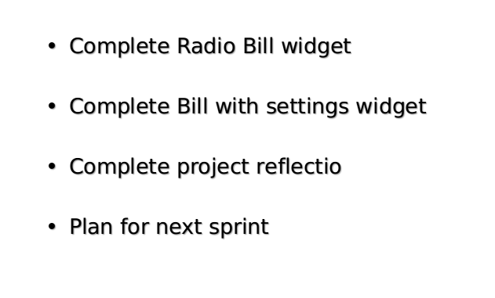
Planned:

Slide 3
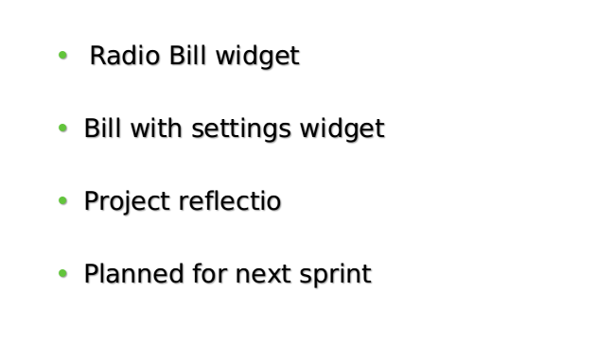
Completed?

Slide 4

Thank You!
Now let's see!
Demo: Dom-intro Widgets

